Slide 1

The Interview Wrap Up
Closing of the interview.
Notes:
I like this presentation because Closing a job interview efficiently is vital to increasing your chances of receiving an offer.
The material is important because it teaches what you need to do at the end of an interview to make a final professional impression.
By the end of our session today you will understand the 3 simple things that end the interview in a polite, professional way.
It is very similar to saying good-by at the end conversation.

Slide 2
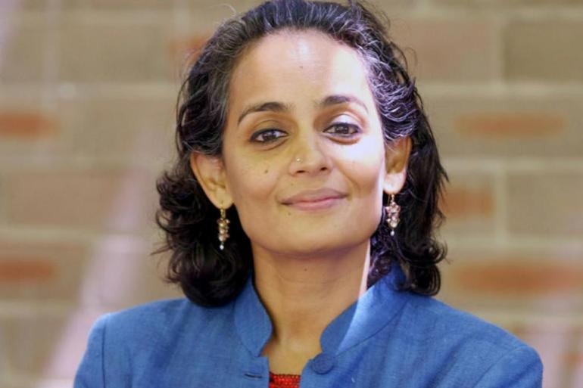
Nearing the End
Do you have any questions for me today?
Ask 2-3 BIG PICTURE questions
Say “I don’t have any more questions right now. Or “That’s all the questions I have right now”.
Notes:
Asking Questions presentation given earlier in the week.
What can I expect the first 30 days on the job?
Is this a new position? If not, why did the previous person leave?
What have past employees done to succeed in this position?

Slide 3
Do 3 Things at the End
Express Gratitude for the opportunity to interview
2. Express interest/excitement in the position
3. Ask/confirm next step in the hiring process

Slide 4
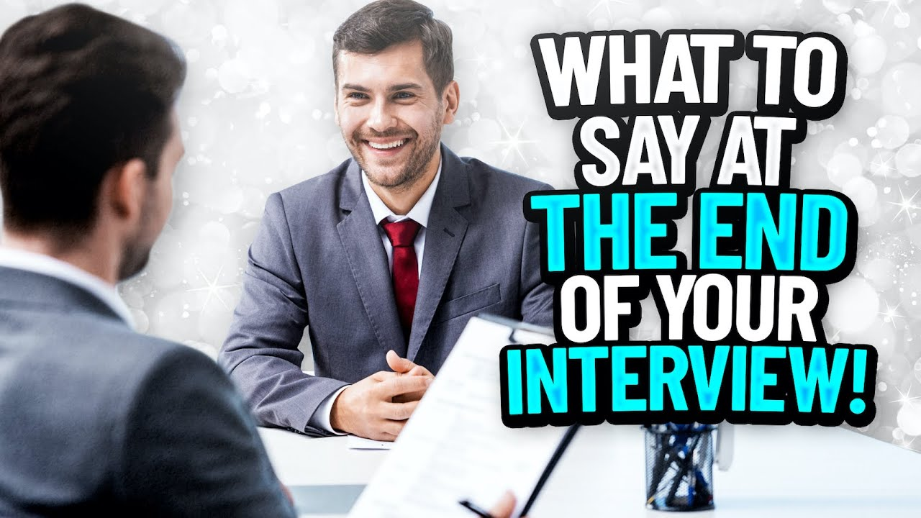
Scenario #1 Demo Conversation

Slide 5

Closing the Interview Scenario #1 Demo Conversation
That’s all the questions I have for now.
Thank you for your time. It’s been nice meeting you and learning about your skills and qualifications.

Slide 6
Two Things to Say at the End
1. Thank you for taking your time to interview me today and telling me more about the company and position.
2. May I ask what the next step will be in the process?

Slide 7
Professionalism
Nearing the end of the interview
Closing the Interview
Saying 2 things at the end
Asking 1 question
Understanding two conversation scenarios (demos)

Slide 8
Ask The Next Step During the Close
What is the next step in the hiring process and by what date do you expect to make a decision?
The top 3 candidates will be contacted by Wednesday to schedule a follow-up interview with team.
Thank you for the information. I’m very excited about this opportunity and I hope to hear from you next week. Good-bye

Slide 9
Scenario #2 Demo Conversation

Slide 10

Scenario #2 Demo Conversation
I don’t have any more questions right now, but if I do can I email you?
Yes of course. Your experience is remarkable, and I think you would be a good fit for this team. I would like to schedule you for follow up interview with the Manager and Team Lead. Are you available on Wednesday afternoon 1:00?
Let me check my schedule to see I have an opening. How long would the next interview be?

Slide 11
The next interview would be 60-90 minutes long.
Respond based on your schedule
I already have something scheduled during that time period. What would be the next available time?
Notes:
Never mention what you have scheduled or a company/client name.

Slide 12
Are you available Thursday morning at 10:00 AM?
Yes, I am available.
Wonderful, so I will send you a zoom invite after our call. That’s all I need for now. I hope you have a good day.
Yes, I will and thank you very much for your time today. I’m very excited about the next interview. Good-bye.
Notes:
Never mention what you have scheduled or a company/client name.

Slide 13
What are the 3 things you do at the end of every interview?
Summary of what you learned:
Notes:
This is going to be in the quiz…

Slide 14
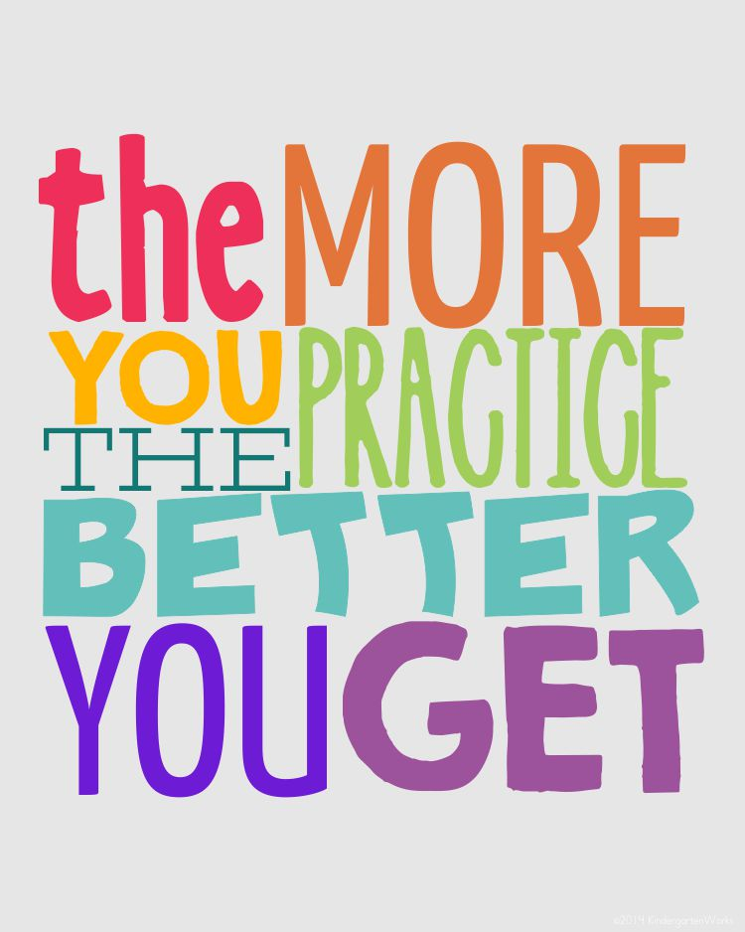
Time to practice what you learned.
Notes:
This is going to be in the quiz…

